Slide 1

Infosys Springboard Internship 5.0 (Batch 2)
GlucoSense-AI Powered Diabetes Detection and Early Intervention
Mentor- Ravi
Presented by
Sri Sai Deepika Nallamilli

Slide 2




Aim
The aim of Glucosense-AI Powered Diabetes Detection and Early Intervention is to leverage advanced technologies, such as AI-driven analytics and continuous glucose monitoring, to detect early signs of diabetes and pre-diabetes. By providing personalized, real-time insights and interventions, the goal is to empower individuals to proactively manage their health, prevent the onset of diabetes, and reduce the risk of complications. This approach aims to improve the overall quality of life, enhance diabetes management, and optimize healthcare outcomes through early detection and continuous monitoring.

Slide 3




Objective
To design and implement an AI-driven solution for early and accurate detection of diabetes, promoting proactive healthcare and timely treatment. The project emphasizes non-invasive techniques, real-time monitoring, and user-friendly technology to enhance diabetes management and improve overall health outcomes.

Slide 4
Introduction
GlucoSense is an innovative project designed to revolutionize diabetes management through advanced artificial intelligence and non-invasive technology. By integrating AI-powered algorithms with cutting-edge sensors, GlucoSense offers an accurate, real-time solution for detecting and monitoring blood glucose levels. This approach not only enhances the ease and comfort of diabetes screening but also empowers individuals to take control of their health.
The system's ability to analyze trends, predict risks, and provide actionable insights makes it a valuable tool for both individuals and healthcare professionals. With its focus on accessibility, accuracy, and user-friendliness, GlucoSense aims to transform diabetes care and improve the quality of life for people across the globe.

Slide 5

Data overview
The dataset for the GlucoSense: AI-Powered Diabetes Detection for Early Intervention project includes the following features:
Polyuria: Frequent urination
Polydipsia: Excessive thirst
Sudden Weight Loss: Unexplained weight loss
Weakness: General feeling of weakness or fatigue
Polyphagia: Excessive hunger
Genital Thrush: Fungal infection around genital area
Visual Blurring: Blurry vision
Itching: Persistent itching
Irritability: Increased irritability or mood swings
Delayed Healing: Slow recovery from wounds or injuries
Partial Paresis: Partial paralysis or muscle weakness
Muscle Stiffness: Stiffness in muscles
Alopecia: Hair loss
Obesity: Excess body weight
The Class column serves as the target label, indicating whether the individual is at risk of diabetes (often labeled as "1" for risk, "0" for no risk).
This dataset provides valuable health and lifestyle indicators for predicting diabetes risk and can be used for machine learning models to assist in early diagnosis.

Slide 6

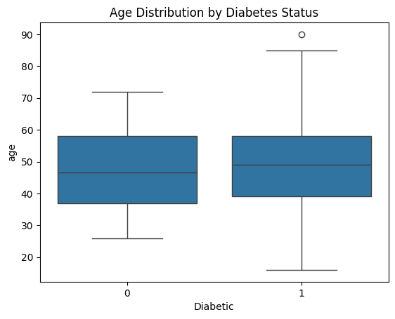
EDA Process
Purpose: Understanding the dataset to uncover trends, patterns, and relationships.
Steps Taken:
Loading and Inspecting Data: Overview of the first few rows.
Descriptive Statistics: Summary of numerical and categorical features.
Data Cleaning: Handling missing values, duplicates, etc.
Univariate and Bivariate Analysis: Distribution of features and their relationships with the target.

Slide 7
EDA Process
Purpose: Understanding the dataset to uncover trends, patterns, and relationships.
Steps Taken:
Loading and Inspecting Data: Overview of the first few rows.
Descriptive Statistics: Summary of numerical and categorical features.
Data Cleaning: Handling missing values, duplicates, etc.
Univariate and Bivariate Analysis: Distribution of features and their relationships with the target.

Slide 8
Data Cleaning and Processing
Handling Missing Values:
Dropped rows with missing data or imputed values.
Outlier Detection: Identified and visualized potential outliers using box plots.
Feature Scaling: Standardized numerical features for model readiness.
Class Imbalance: Checked for imbalance in the target variable and planned mitigation.

Slide 9
Data Visualization
Histograms: Distribution of numerical features like Obesity, Weakness, etc.
Bar Plots: Frequency of target variable classes (Class = 0 or 1).
Correlation Heatmap: Visual representation of how features are correlated.
Box Plots: Detection of outliers in numerical features.

Slide 10
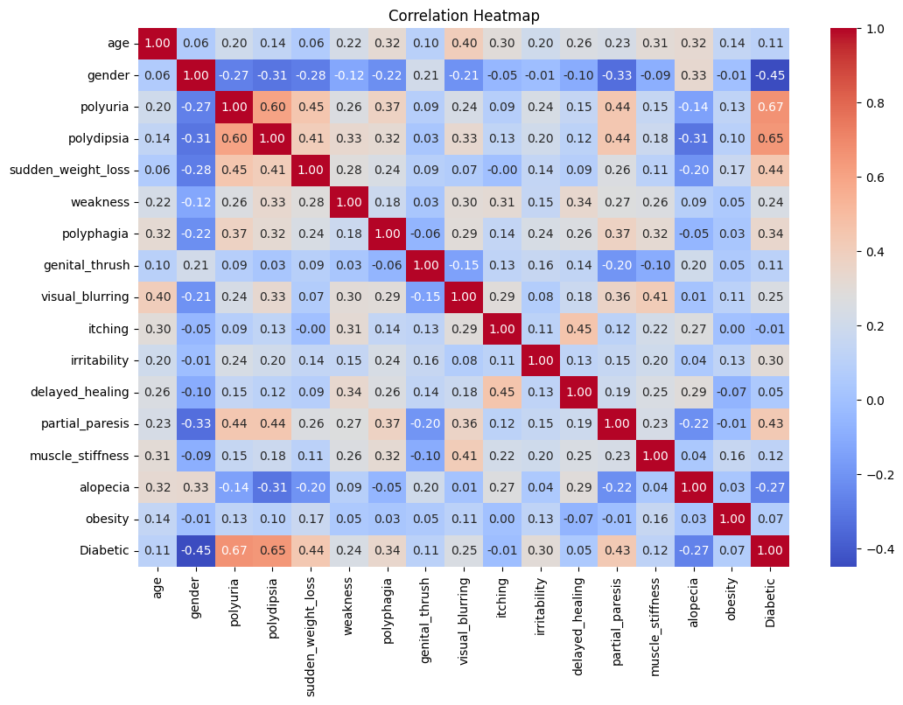
Feature Selection
Feature selection is crucial in identifying the most relevant variables for building effective predictive models. In the context of diabetes prediction, it helps to focus on the most impactful symptoms and conditions.
Selecting features with strong correlations can improve the accuracy of diabetes prediction models. Focusing on these key indicators helps streamline the model-building process and enhances predictive performance.

Slide 11
Dimensionality Reduction
Dimensionality reduction is a crucial technique in data science and machine learning, aiming to reduce the number of input variables in a dataset. This process helps in simplifying models, reducing computation time, and eliminating noise, while preserving essential data patterns and structures.
Principal Component Analysis (PCA)
PCA transforms the data into a new coordinate system, where the greatest variances of the data lie on the first few dimensions called principal components.
It's widely used for its simplicity and effectiveness in reducing dimensionality while preserving variance.

Slide 12
Classification models
Model classification refers to the process of categorizing data points into distinct classes or categories using machine learning algorithms. It's a fundamental task in supervised learning, where the goal is to learn from labeled data and make predictions on unseen data.
Logistic Regression
Description: A linear model for binary classification that estimates the probability of a class.
Use Cases: Binary tasks like email filtering.
Random Forest
Description: An ensemble method using multiple decision trees for improved accuracy.
Use Cases: Tasks with complex data patterns.
Support Vector Machine (SVM)
Description: Finds the optimal hyperplane that separates classes in the feature space.
Use Cases: High-dimensional spaces and small datasets.
K-Nearest Neighbors (KNN)
Description: Classifies based on the majority label of the nearest neighbors.
Use Cases: Simple and intuitive tasks with smaller datasets.
Chi-Square Test
Description: A statistical test to determine if there is a significant association between categorical variables.
Use Cases: Feature selection by testing the independence of variables in the classification task.

Slide 13
Hyperparameter Tuning
Hyperparameter tuning is the process of optimizing the hyperparameters of a machine learning model to improve its performance. Unlike model parameters, which are learned during training, hyperparameters are set prior to the training process and play a crucial role in how the model learns from the data.
Evaluation Metrics: Common metrics include accuracy, precision, recall, F1 score,used to assess the performance of models with different hyperparameters.
Cross-Validation: Ensures the robustness and generalizability of the model by evaluating it on multiple subsets of the data.

Slide 14
Model Selection
Random Forest excels in accuracy, stability, and interpretability, making it the optimal choice for diabetes prediction in healthcare applications.
Accuracy: 97.12%
Outperforms other models, crucial for reliable diagnosis in healthcare.
Stability:
Low standard deviation (0.0163), ensuring consistent performance across data splits.
Cross-Validation:
Maintains high accuracy (97.12%) in cross-validation, reducing overfitting.
Feature Importance:
Identifies key factors (e.g., polyuria, weight loss) critical for healthcare decisions.
Ensemble Advantage:
Combines multiple decision trees, reducing overfitting and improving prediction stability.
Training Time:
0.2565 seconds, acceptable trade-off for high accuracy and reliability.

Slide 15
Conclusion
Glucosense demonstrates great potential as an advanced tool for diabetes prediction. Through the use of sophisticated models like Random Forest, it achieves high accuracy and stability, ensuring reliable and consistent predictions. The system's ability to identify key features (e.g., polyuria, weight loss) enhances its interpretability, providing actionable insights for healthcare professionals. By leveraging ensemble learning techniques, Glucosense offers robust performance while reducing the risk of overfitting. With its user-friendly interface and fast response time, Glucosense is a powerful tool for improving early diabetes detection and supporting better healthcare decision-making.

Slide 16
THANK YOU

